Slide 1

CMR COLLEGE OF ENGINEERING & TECHNOLOGY
Kandlakoya, Medchal, Hyderabad - 501401
Department of Computer Science and Engineering
CROP YEILDING & FERTILIZER RECOMMENDATION USING MACHINE LEARNING
Batch No.:60
Name of the student:
20H51A0554 V.Vijay
20H51A0562 D.Raja Goud
20H51A05E3 K.Jeevitha
Under esteemed guidance of
Ms.Komal Parashar
Asst.Professor-CSE
Batch: 2020-2024 Major Project Phase 2

Slide 2
Outline
Abstract
Introduction
Research Objective
Problem Definition
Scope of the Project
Literature Review
Implementation of Existing system
Proposed Method Description
Architecture/Block diagram
Conclusion
References
Notes:
2

Slide 3
Abstract
Notes:
3

Slide 4
ABSTRACT
India, a nation with a strong agricultural backbone, relies heavily on the forecast for crop production and agro-industrial products for its economy. The domain of data mining is gaining traction as a valuable tool in the analysis of crop yields.
Predicting yields is a crucial aspect of agriculture, as it allows farmers to anticipate their potential harvest.
This involves the examination of various related factors such as the pH level, which indicates soil alkalinity. Other important elements include the percentages of essential nutrients like Nitrogen (N), Phosphorus (P), and Potassium (K), as well as the temperature, rainfall, and humidity levels in the region.
These data attributes are examined and used to train a range of appropriate machine learning algorithms to create a predictive model. This system aims to provide accurate crop yield predictions and offer users specific recommendations on the type of fertilizer required.
The predictions are considering the atmospheric and soil parameters of the territory, with the goal of enhancing crop yield and thereby increasing the farmer’s revenue.

Slide 5
INTRODUCTION
Notes:
5

Slide 6
Introduction
India, a highly populated country, faces food security challenges due to varying climatic conditions.
Soil type and fertility play crucial roles in crop yield.
ICT (Information and Communication Technology) and Data Mining can assist farmers in making informed decisions regarding crop cultivation.
The project's goal is to maximize crop yield while minimizing resources used or cost spent by the farmers.
Precision agriculture focuses on enhancing crop quantity, profitability, and sustainability.
Understanding weather conditions is vital for successful crop growth.
Fertilizer usage is a significant factor in crop yield.
Machine learning algorithms can predict the most efficient crop yield output, particularly as weather conditions can change dramatically.
By understanding crop and yield patterns, technology empowers farmers to make informed decisions for their specific cropping situations, ultimately contributing to the improvement of the Indian economy.
Notes:
6

Slide 7
Research Objective
Notes:
7

Slide 8
Research objective
Crop Yield Prediction :
To Develop and implement machine learning models to accurately predict crop yields for various crop types in specific geographic regions.
Fertilizer Recommendation :
To Develop machine learning algorithms and recommendation systems that determine the optimal type and quantity of fertilizers for specific crops and soil conditions.
Data Integration and Analysis:
Explore methods for integrating and analyzing a wide range of data sources, including historical data, soil nutrient profiles, weather data.
Farmer’s Decision Support:
Design user-friendly interfaces using powerful web technologies and decision support systems that enable farmers to access and interpret the recommendations provided by machine learning models.

Slide 9
Problem Definition
Notes:
9

Slide 10
Problem Definition
The problem addressed in the "Crop Yield Prediction and Fertilizer Recommendation Using Machine Learning" project is the need to improve agricultural productivity and sustainability in the face of increasing challenges. Crop yield variation, suboptimal fertilizer usage, and environmental concerns have prompted the development of a data-driven solution to assist farmers in making informed decisions regarding crop cultivation and fertilizer application.
Key Aspects of the Problem:
Crop Yield Variability: Farmers face unpredictable fluctuations in crop yield due to complex interactions of environmental factors, soil conditions, and crop-specific requirements.
Fertilizer Usage: Wrong or superfluous use of fertilizers can result in increased production costs, environmental pollution, and nutrient imbalances in soil.
User-Friendly Decision Support: Farmers often lack access to tools and information needed to make data-driven decisions. The problem is to design user-friendly interfaces and decision support systems.

Slide 11
Scope of the Project
Notes:
11

Slide 12
Scope of the Project
The system under consideration suggests the most appropriate crop for a specific land plot, taking into account factors like annual precipitation, temperature, humidity, and soil pH. Among these variables, the system autonomously forecasts annual rainfall by utilizing past-year data through the SVM algorithm, while the user must input the remaining parameters. Linear regression, Random forest regressor, Support vector regressor are used
In the output segment, the system provides information about the recommended crop, the quantity of seeds required per acre, current market prices, and an estimated crop yield. Additionally, the system relies on user-provided NPK values in the input section to determine the necessary NPK (Nitrogen, Phosphorus, and Potassium) ratios for the suggested crop.

Slide 13
Literature Review
Notes:
13

Slide 14
Comparison table for the existing system
S.No | Authors and Journal Name& Year of publication | Problem Statement | Name of the Proposed solution/Method | Solution | Remarks
1 | Ananthara,M.G.etal.(2013,February) | Develop an accurate and scalable crop yield prediction model for paddy, rice, and sugarcane in India. | Crop Recommendation System using Machine Learning | Prediction model for datasets pertaining to agriculture which is called as CRY algorithm for crop yield using beehive clustering techniques. Their analysis was mainly in paddy, rice and sugarcane yields in India | The model appears to focus on paddy, rice, and sugarcane crops. Applying this model to other crops may not be straightforward, and its effectiveness for these specific crops may not generalize well to other crops.
2 | Chawla, I. et al. (2019, August) | Build better crop yield prediction models for farmers using different data and methods to make farming decisions easier and more reliable | Fuzzy Logic based Crop Yield Prediction using Temperature and Rainfall parameters predicted through ARMA, SARIMA, and ARMAX models | They used fuzzy logic for crop yield prediction through statistical time series models.Their prediction was classification with levels ‘good yield’ , ‘very good yield’ | The accuracy of the predictions heavily depends on the quality of the input data. Inaccurate or incomplete temperature and rainfall data can lead to unreliable predictions..

Slide 15
Comparison table for the existing system
S.No | Authors and Journal Name& Year of publication | Problem Statement | Name of the Proposed solution/Method by authors | Solution | Remarks
3 | Chakrabarty,A.etal.(2018,December) | Agriculture work in Bangladesh is mostly done in old ways which directly affects our economy. In addition, institutions of agriculture are working with manual data which cannot provide a proper solution for crop selection and yield prediction. | A Deep Neural Network Approach for Crop Selection and Yield Prediction in Bangladesh | He analyzed crop prediction in the country of Bangladesh where they majorly cultivate three kinds of rice, Jute, Wheat, and Potato. Their research used a deep neural network where the data had around 46 parameters into their consideration. | Implementing and maintaining a neural network-based system can be costly, both in terms of computational resources and expertise required.
4 | Ramalatha, M.et al. (2018, October) | Develop an accurate and scalable crop yield prediction model rice, maize, Ragi, Sugarcane, and Tapiocain in TamilNadu | Prediction of major crop yields of Tamilnadu using K-means and Modified KNN | They used a hybrid approach of combining K-means clustering and classification based on modified KNN approach. The data was collected from TamilNadu, India where the majorly concentrated crops were rice, maize, Ragi, Sugarcane, and Tapioca | The limitations of the K-means clustering and modified KNN hybrid approach in crop analysis include sensitivity to initial cluster settings, difficulty in explaining recommendations, and potential data quality and temporal information gaps.

Slide 16
Implementation of Existing System
Crop Recommendation System using Machine Learning: Prediction model for datasets pertaining to agriculture which is called as CRY algorithm for crop yield using beehive clustering techniques. Their analysis was mainly in paddy, rice and sugarcane yields in India. The model appears to focus on paddy, rice, and sugarcane crops. Applying this model to other crops may not be straightforward, and its effectiveness for these specific crops may not generalize well to other crops.
Fuzzy Logic based Crop Yield Prediction: They used fuzzy logic for crop yield prediction through statistical time series models. Their prediction was classification with levels ‘good yield’ , ‘very good yield’
A Deep Neural Network Approach for Crop Selection and Yield Prediction in Bangladesh: They analyzed crop prediction in the country of Bangladesh where they majorly cultivate three kinds of rice, Jute, Wheat, and Potato. Their research used a deep neural network where the data had around 46 parameters into their consideration.
Prediction of major crop yields of Tamilnadu using K-means and Modified KNN: They used a hybrid approach of combining K-means clustering and classification based on modified KNN approach. The data was collected from TamilNadu, India where the majorly concentrated crops were rice, maize, Ragi, Sugarcane, and Tapioca

Slide 17
Proposed Method Description
Initially, comprehensive datasets encompassing historical crop yields, soil properties, weather conditions, and fertilizer applications are collected and preprocessed to handle missing values, outliers, and categorical variables. System is trained and tested on the preprocessed data sets using algorithms like support vector regressor, logistic regressor, random forest regressor.
Crop Yield Prediction:
The expected crop yield is for the input data is predicted using the logistic regressor algorithm. And best suitable crop for that land in view of best yield is predicted using Regressor Support Vector Algorithm
Fertilizer Recommendation:
The type of fertilizer to be applied for the respective land considering the input data is recommended using the Random Forest Regressor algorithm.

Slide 18

Proposed Method Description
Web Application:
The system prioritizes seamless user interaction by enabling user registration through OTP verification with registered Email and input of essential details. Through API integration, users gain access to external functionalities like real-time weather updates. This comprehensive approach enhances user engagement, provides valuable information, and facilitates both secure interactions within the system. The server and MongoDB from backend works effectively ensuring response to the frontend without any delay. History of predictions done by the user is displayed in profile page to get rid of the need of multiple predictions on the same data.

Slide 19
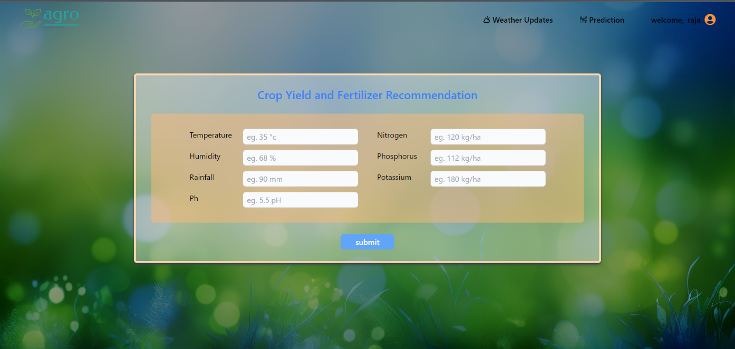
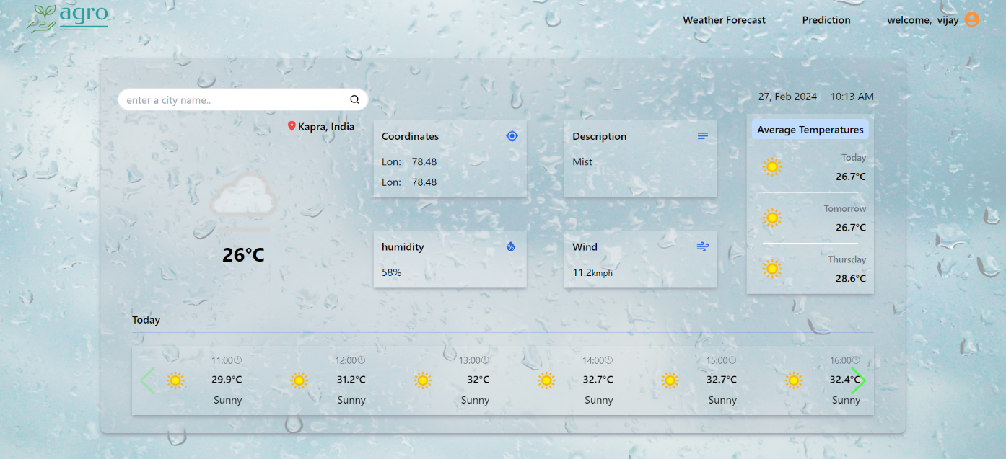
Proposed Method Description

Slide 20
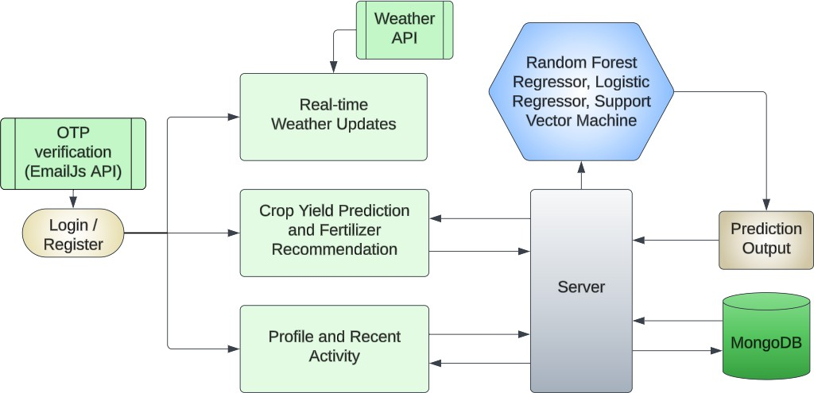
Architecture / Block Diagram

Slide 21
Performance Measure
This project's experimentation phase has yielded commendable results, attaining an impressive accuracy level of 92% in both predicting crop yields and type of fertilizers.
The web application showcases effective user engagement, seamlessly integrating various features to deliver a user-friendly experience. The server and MongoDB from backend works effectively ensuring response to the frontend without any delay.
Showing the history of prediction done by the user in profile page is beneficial for eliminate the need of multiple predictions on the same data. And the additional feature of weather forcast works seamlessly in rendering the Real-time weather data from weather API, and OTP verification adds an additional security measure that ensures maintaining the authenticity of user accounts on our application.

Slide 22
Performance Measure
Algorithms | Accuracy %
Support Vector Machine | 89
Random Forest Regression | 90
Logistic Regresssion | 92

Slide 23
Result
Our proposed system marks a significant leap in conventional agriculture through the seamless integration of advanced machine learning.
By employing the Regression algorithms, the system delivers highly accurate crop yield, suitable crop predictions and fertilizer recommendations.
The user-friendly web interface streamlines the registration process with OTP verification and prediction process based on user input, ensuring farmers receive tailored suggestions effortlessly.
The incorporation of features like real-time weather updates, user activity enhancing the overall user experience.
With an impressive 92% total accuracy for crop yield prediction and 90% for fertilizer recommendation, this system stands poised to revolutionize agricultural methods, offering farmers priceless information for informed decision-making.

Slide 24
Conclusion
Presently our farmers are not effectively using technology and analysis, so there may be a chance of wrong selection of crop for cultivation that will reduce their income.
To reduce those type of loses we have developed a farmer friendly system with GUI, that will predict which would be the best suitable crop for particular land and this system will also provide information about required nutrients to add up, required seeds for cultivation, expected yield and market price.
So, this makes the farmers to take right decision in selecting the crop for cultivation such that agricultural sector will be developed by innovative idea.

Slide 25
Future Work
The future of crop yield and fertilizer recommendation systems using regression algorithms holds immense potential for revolutionizing agricultural practices.
The accuracy of the predictions can be improved through incorporating more advanced machine learning techniques.
Internet of things(IOT) devices and sensor data for real-time monitoring of environmental factors such as temperature, and nutrient levels can be incorporated.
Collaborating with agricultural research institutions, government agencies, and farmers to collect and share data, leading to more comprehensive and accurate models.

Slide 26
References
Shivnath Ghosh and Rode S V 2014 Predicting agricultural crop productivity neural networks with artificial intelligence and the International Journal of Innovative Research in Electrical, Electronics, Instrumentation, and Control Engineering, Vol. 2, Issue 1, pages 683–626.
P. Vinciya, Ganesh P and Ramalatha M 2018 Tamil Nadu’s primary agricultural production predicted using K-means and modified KNN 2018 3rd Conference on Electronic Systems and Communication, International (ICCES) pp 88-93 Doi:10.1109/CESYS.2018.8723956.
Zhihao Hong, Rajpurohit V S and Shweta S 2019 Crop yield forecasting using techniques for machine learning IEEE Fifth International Convergence in Technology Conference(I2CT) pp1-5 Doi: 10.1109/I2CT45611.2019.9033611.
Sabri Arik, Venkat P S, Avinash B L and Jabber B 2020 Machine learning-based forecast of crop yields based on Indian agriculture 2020 International Conference for Emerging Technology (INCET) pp 1-4 Doi: 10.1109/INCET49848.2020.9154036.
Vanees beer Singh, Vaishnavi P and Kishore M 2020 Crop forecasting with artificial intelligence Third International Congress of Inventive Technology and Smart Systems (ICSSIT) 2020 pp 926-32 Doi: 10.1109/ICSSIT48917.2020.9214190.

Slide 27
Thank You!

